Slide 1
MEDIK
REQUIREMENT, DESIGN AND TESTING FOR TELEMEDCINE APP
COURSE INSTRUCTOR: DR. TSAGUE ALINE

Slide 2
INTRODUCTION
Telemedicine applications, also known as telehealth apps, have emerged as transformative tools in the healthcare landscape. With the growing need for medical attention without any latency, mobility issues and other challenges hindering the offering of quick medical services at maximum comfort, medical services through telecommunication are at high need. These mobile applications enable individuals to access healthcare services remotely, bridging geographical distances and overcoming mobility challenges. By leveraging the power of smartphones and other digital devices, telemedicine applications are revolutionizing the way healthcare is delivered and consumed .
The application's core functionalities include:
Real-time video and audio consultations
Secure messaging
Online prescription generation
Pharmacy services
Appointment scheduling

Slide 3
PROJECT DETAILS, REQUIREMENT DESCRIPTION AND STANDARDS ANALYSIS
FUNCTIONAL REQUIREMENTS:
➢ User Authentication and Security of User Data:
➢ Patient-Healthcare Provider Communication and Consultation
➢ Payment Processing and Transactions
➢ Appointment Scheduling and Management
➢ Medical Records Management
➢ Prescription Services
NON-FUNCTIONAL REQUIREMENTS:
➢ Security of telemedicine application
➢ Usability and User Experience
➢ Reliability and Availability
➢ Accessibility
➢ Performance and Scalability

Slide 4
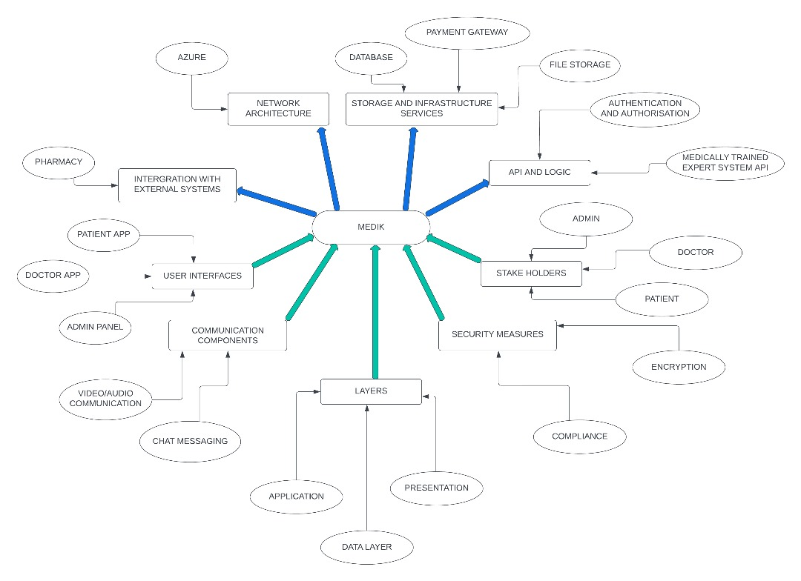
ARCHITECTURAL REQUIREMENTS

Slide 5
INTERNATIONAL QUALITY STANDARDS FOR TELEMEDICINE APPS
Health Insurance Portability and Accountability Act(HIPAA)
General Data Protection Regulation (GDPR)
International Organization for Standardization (ISO) 27001
Digital Imaging and Communications in Medicine (DICOM):

Slide 6
ANALYSIS AND RESEARCH ILLUSTRATION FOR MEDIK
> OVERVIEW
> ANALYSIS
> RESEARCH
> ILLUSTRATION

Slide 7
SYSTEM, USER INTERFACE (UI) AND DATABASE DESIGN OF MEDIK 1) SYSTEM DESIGN

Slide 8
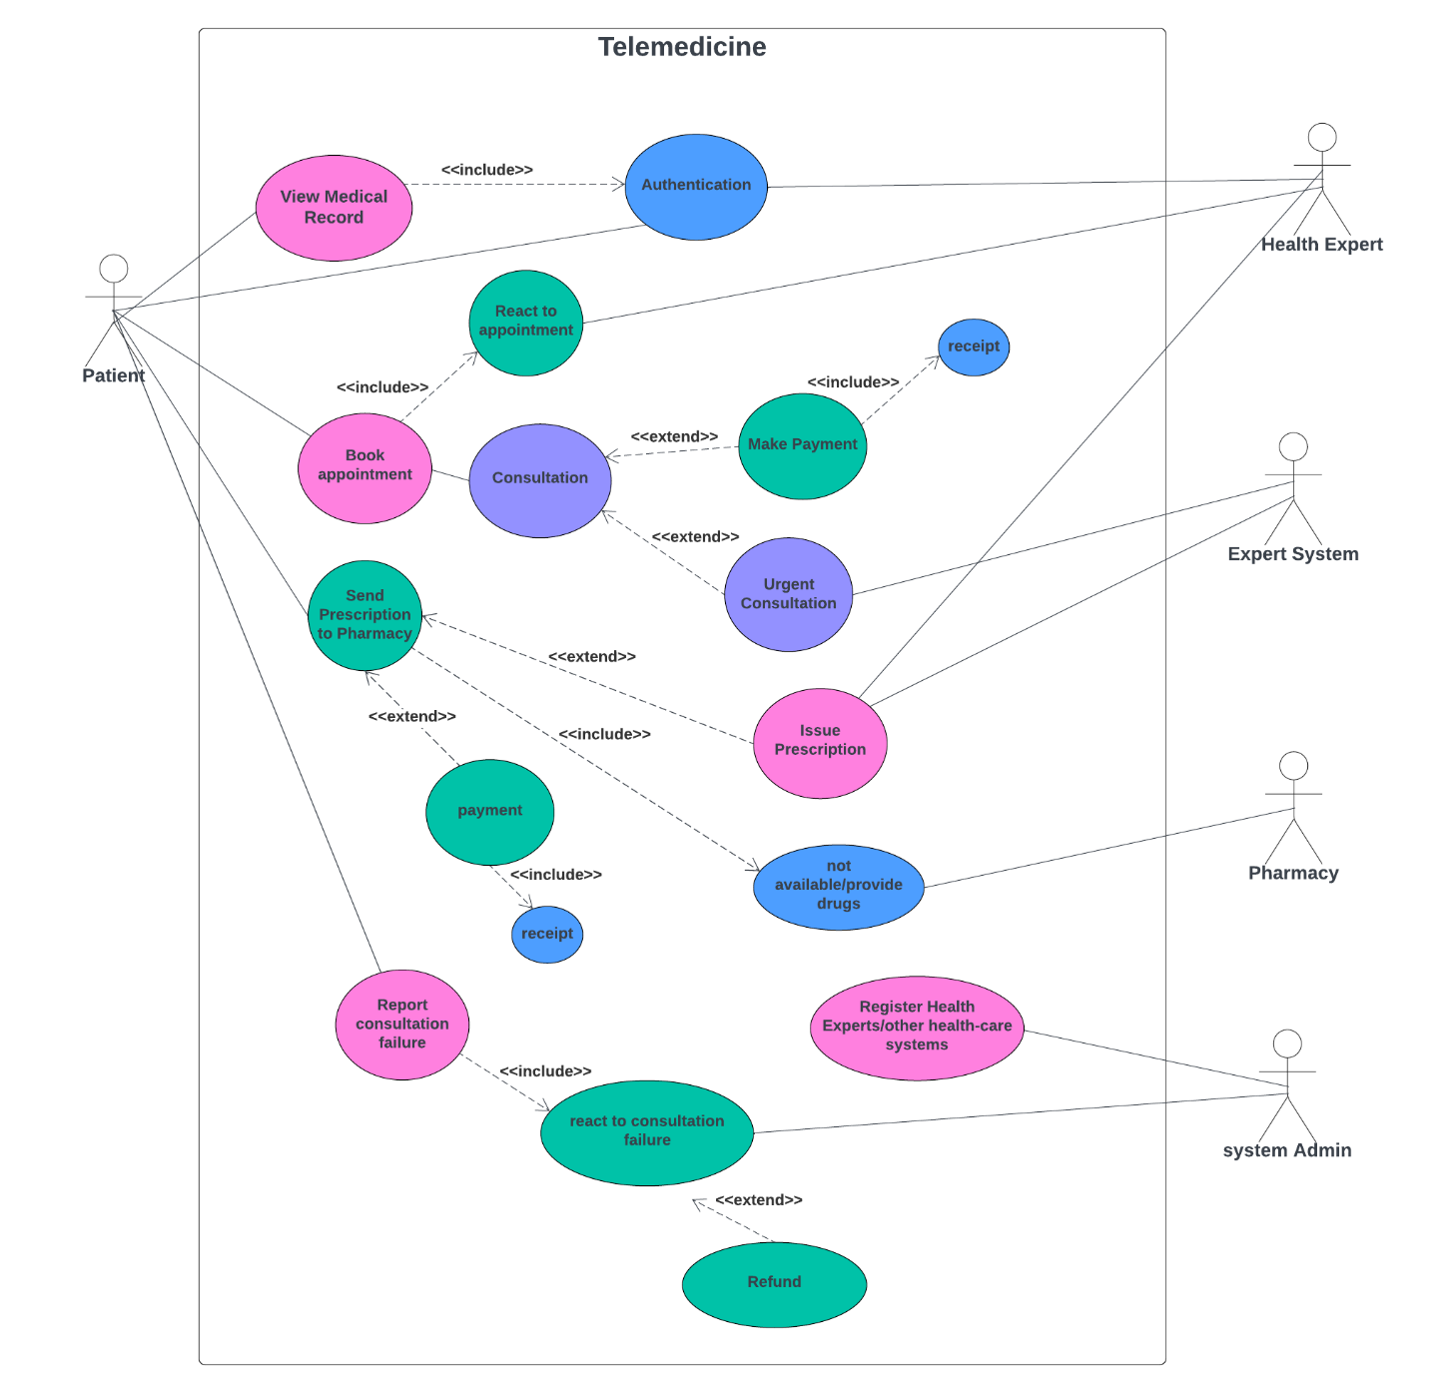

Slide 9
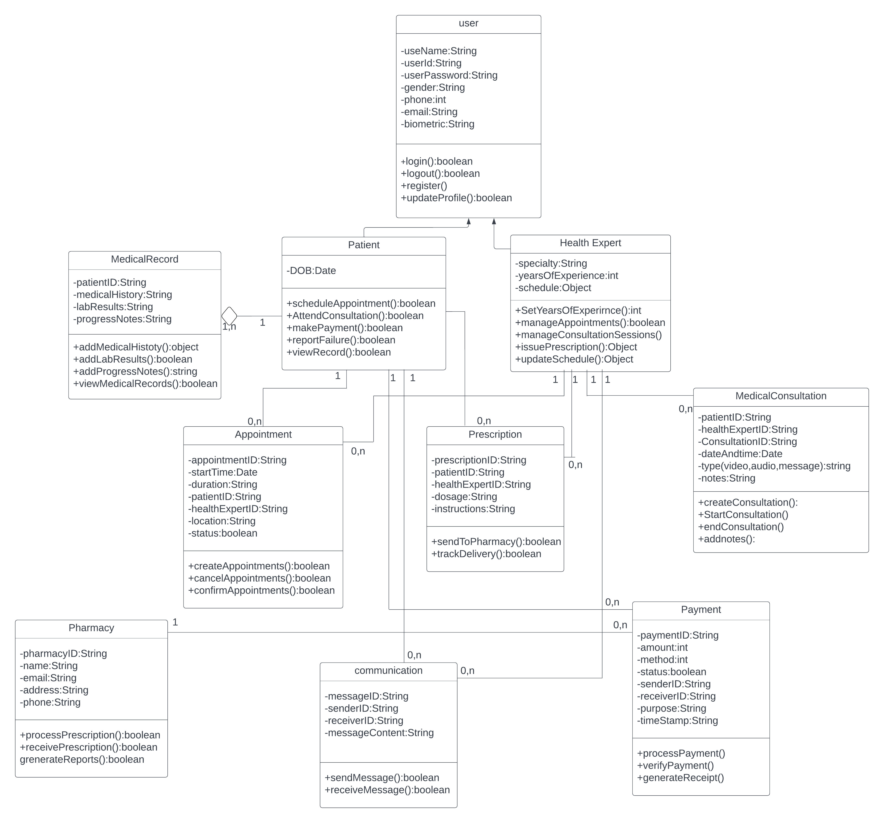

Slide 10
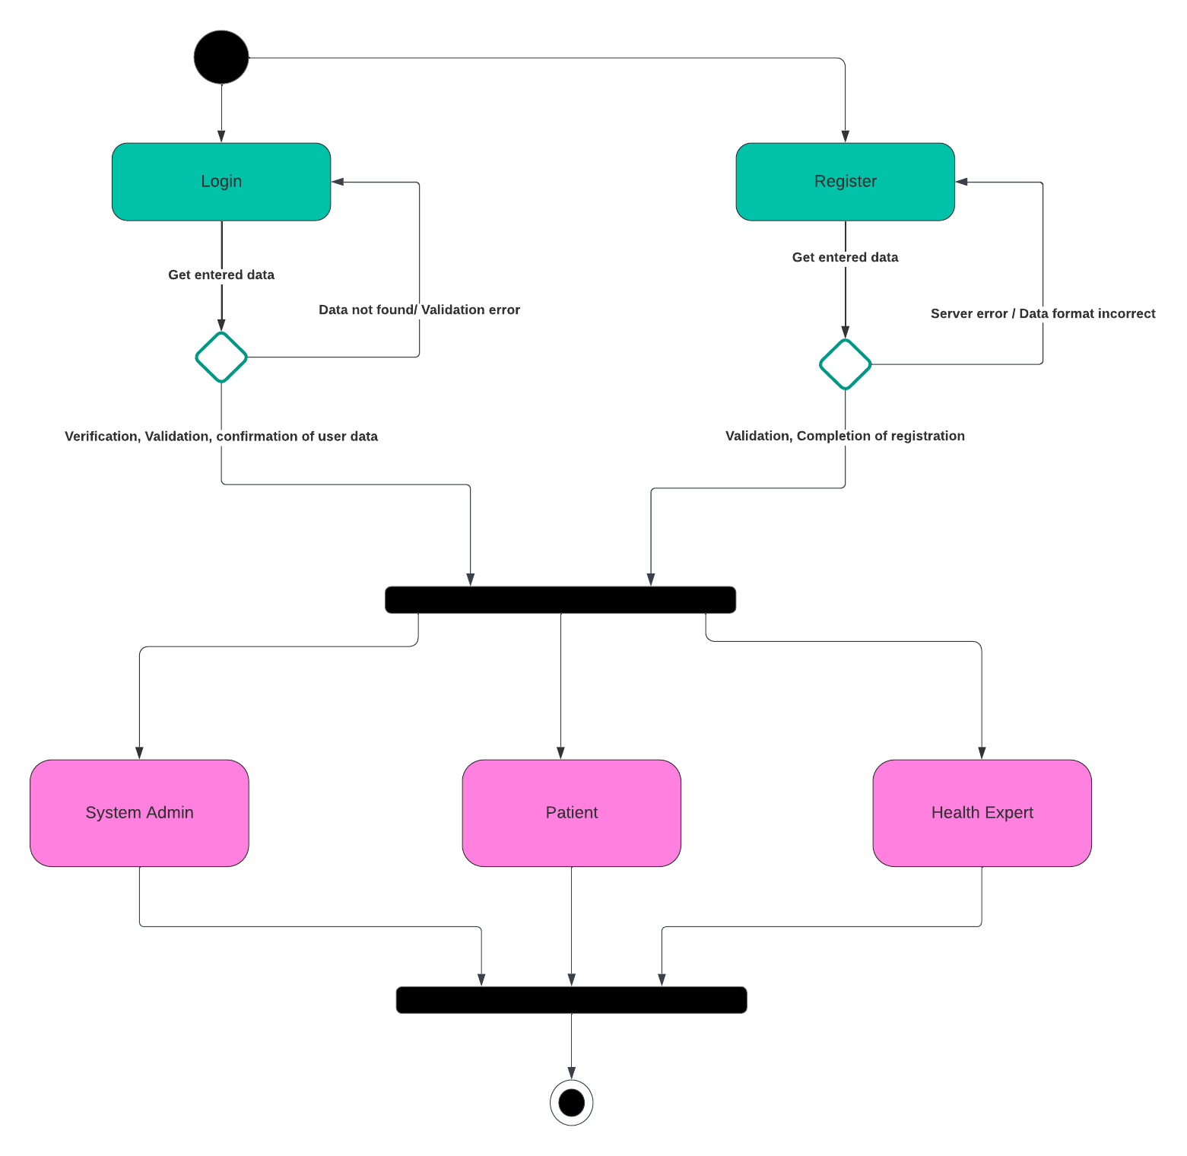
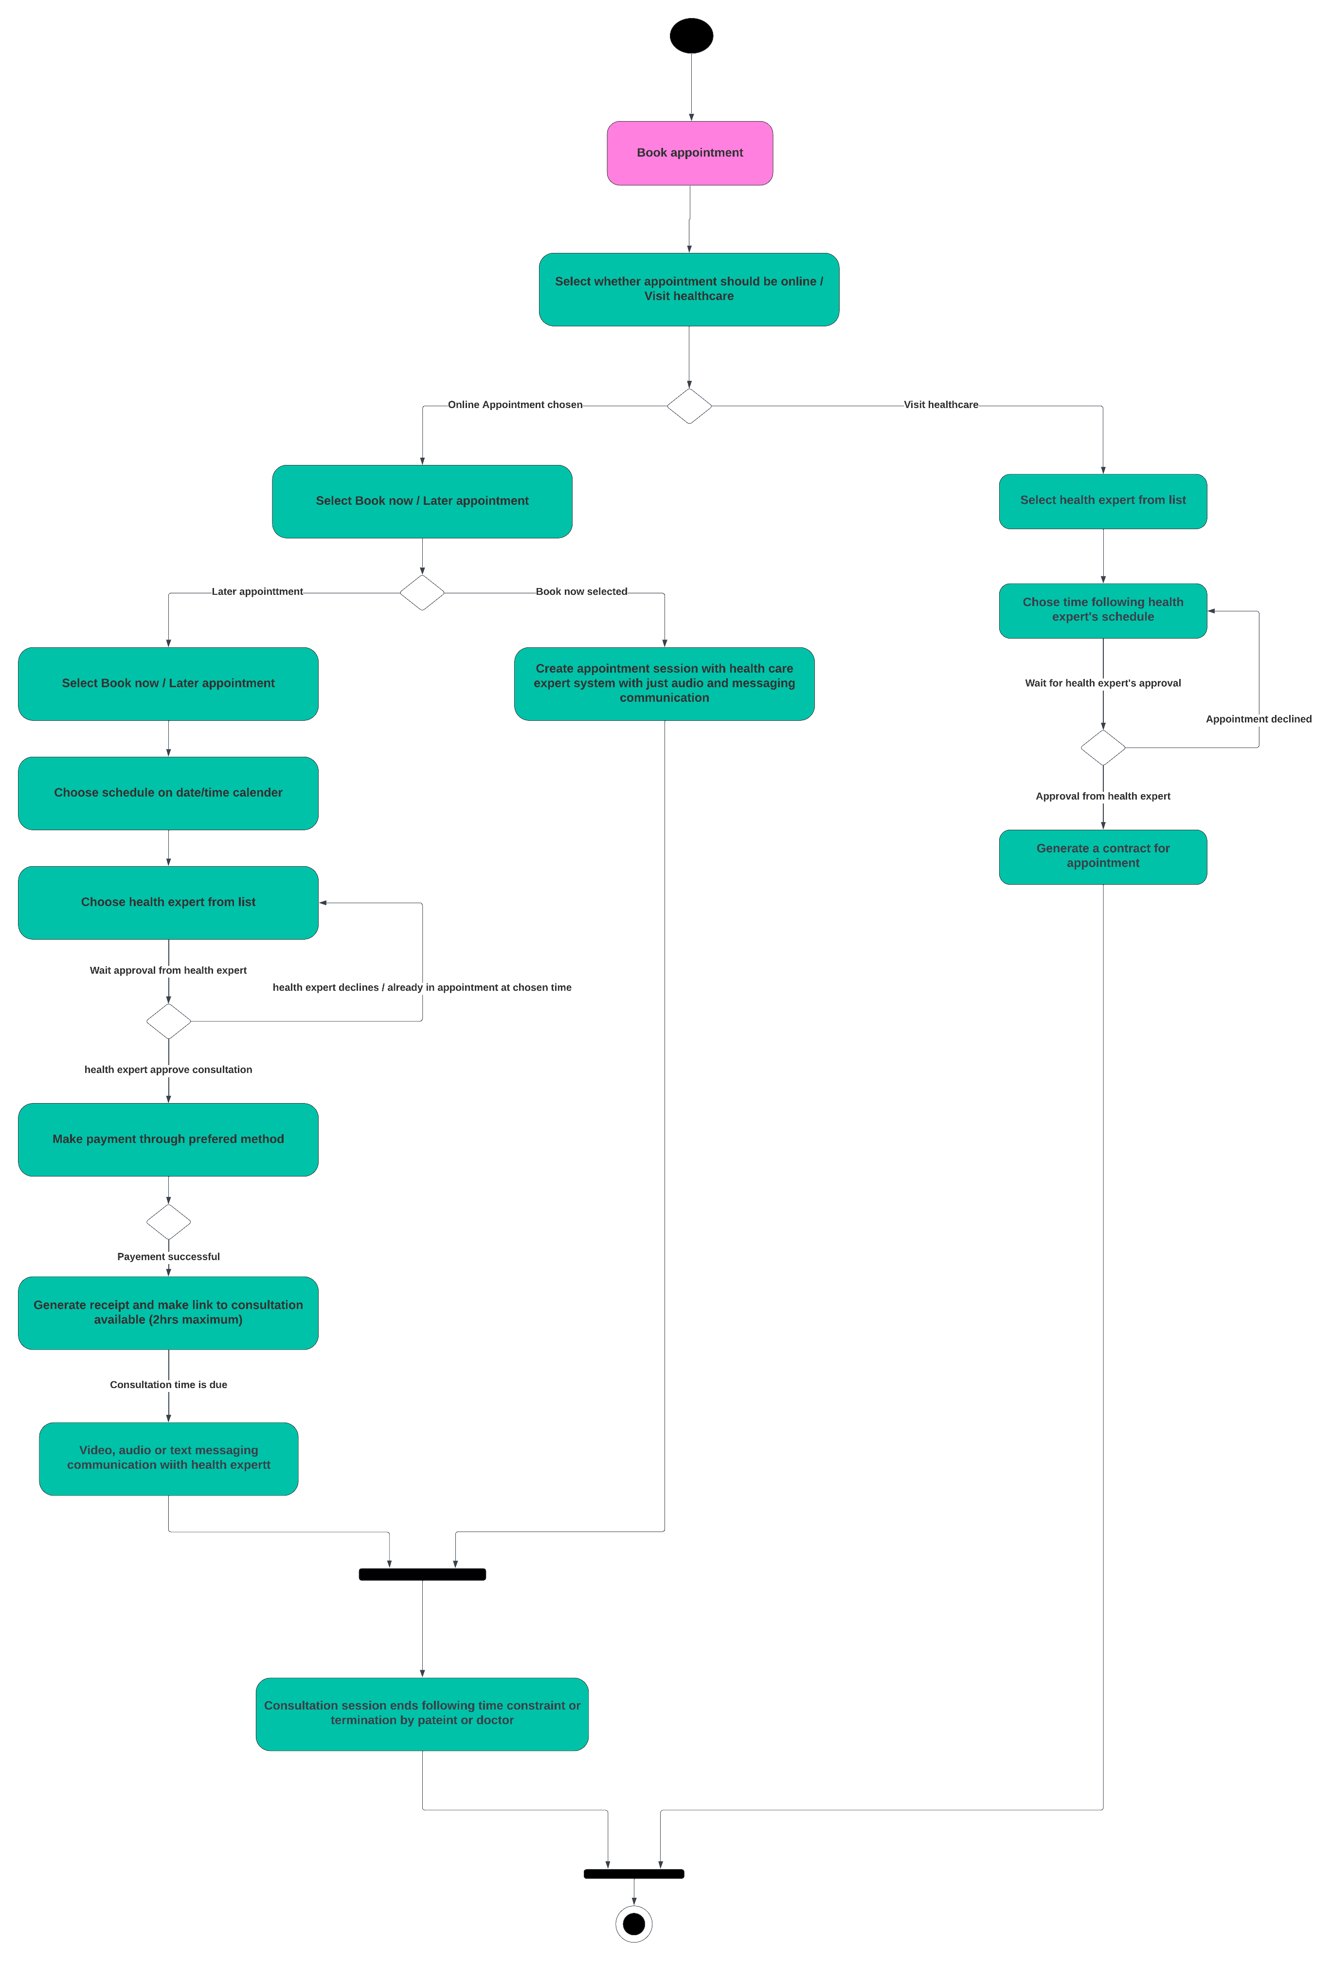
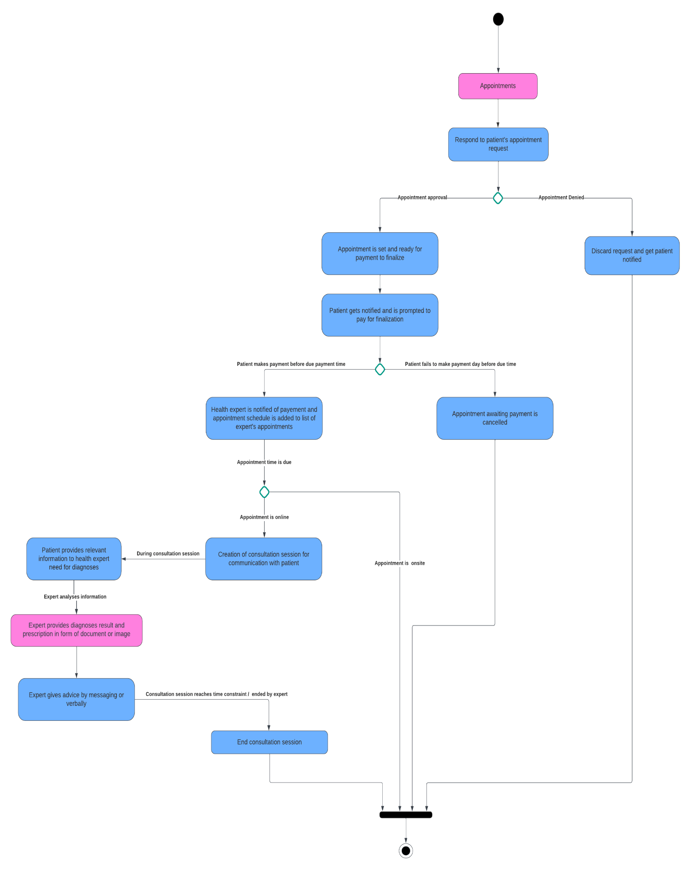
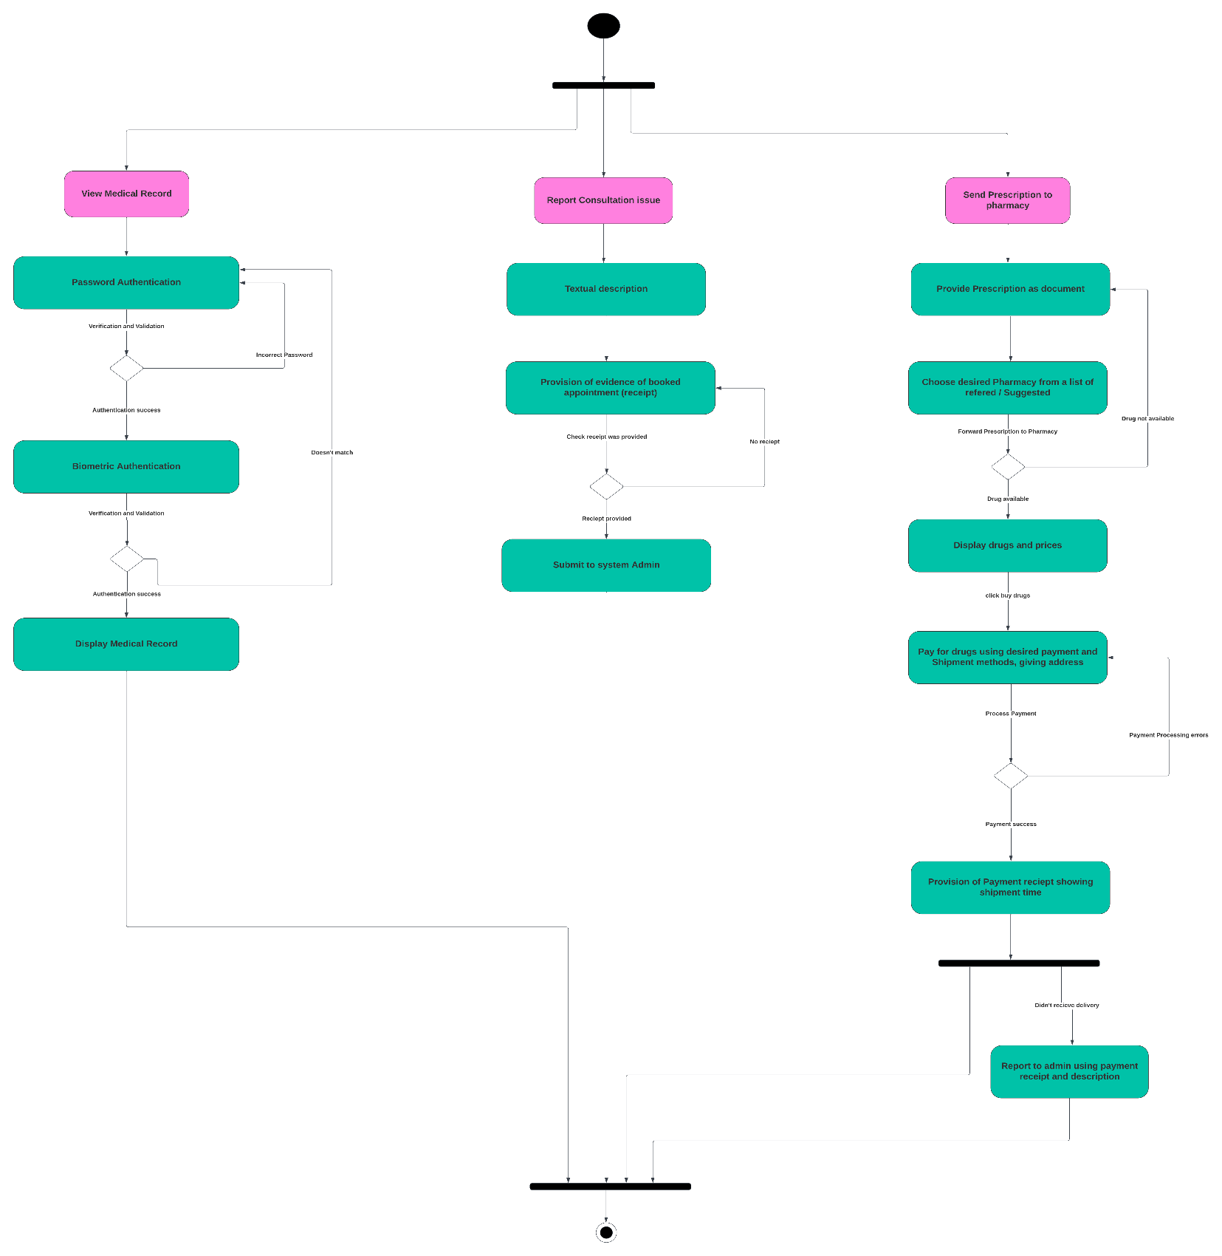

Slide 11
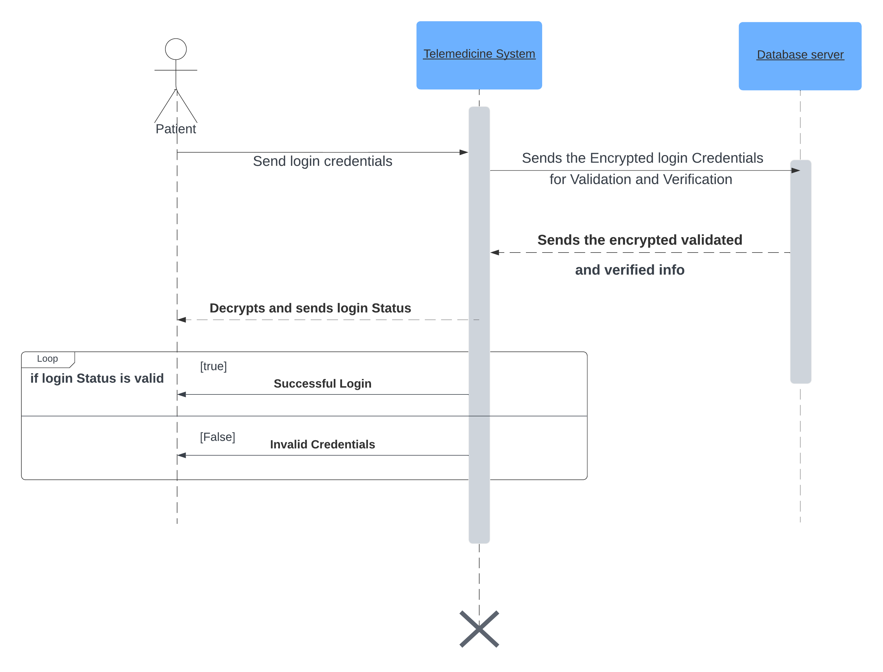
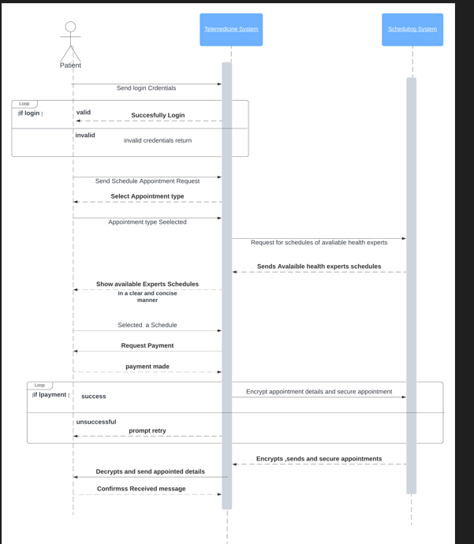
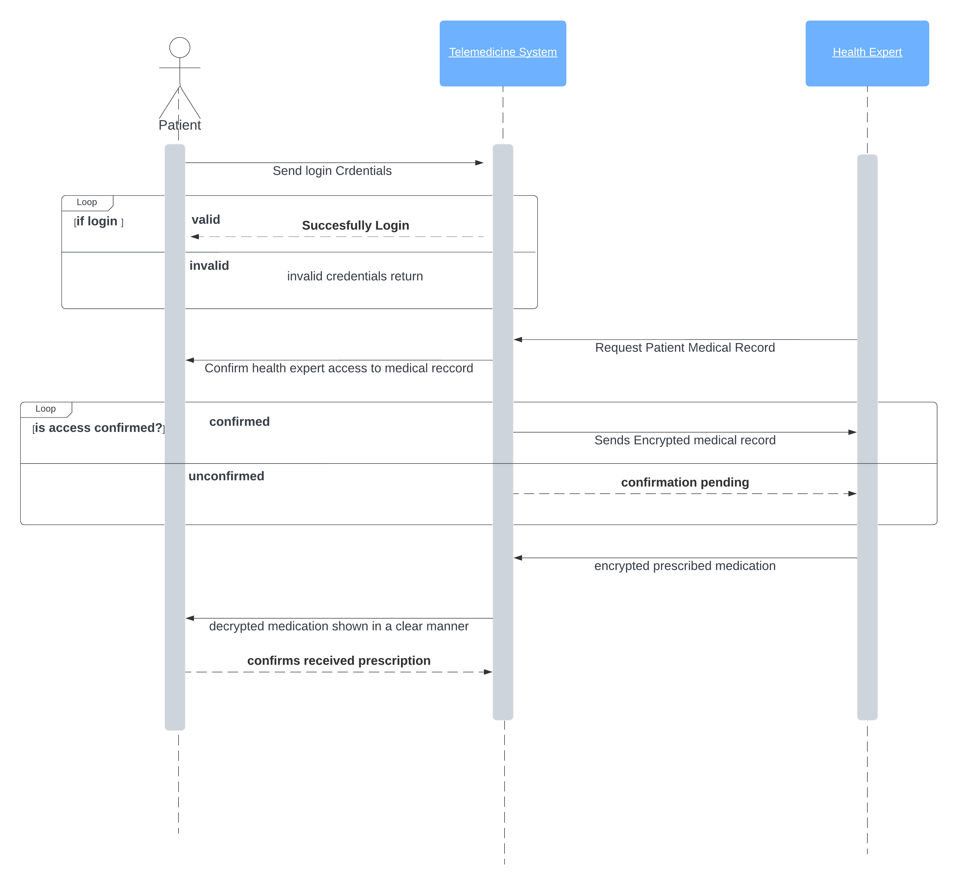

Slide 12
2) UI DESIGN

Slide 13
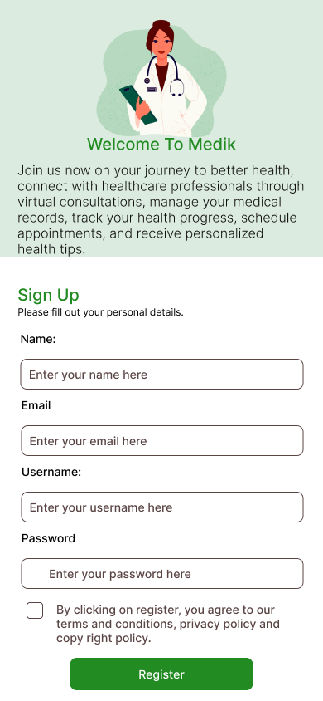
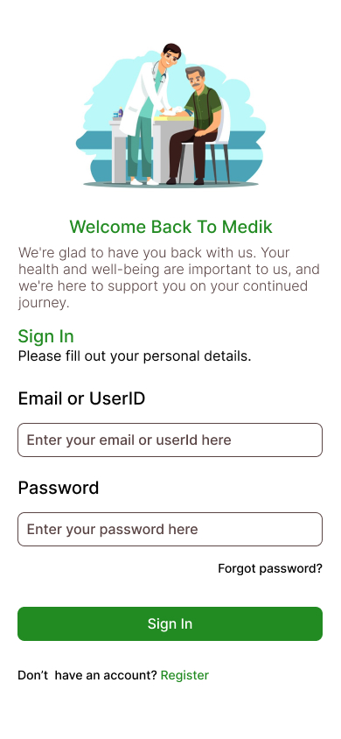
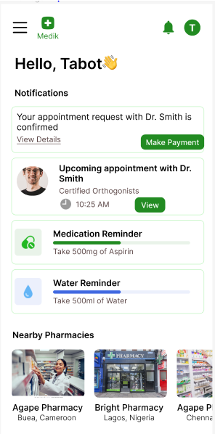

Slide 14
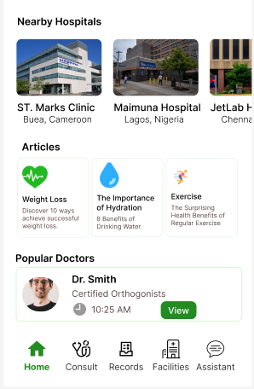
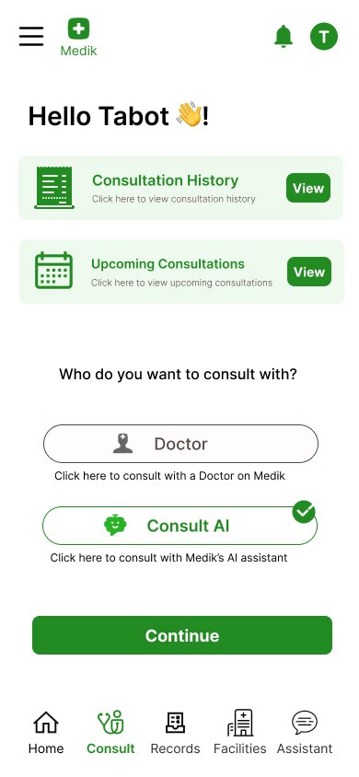
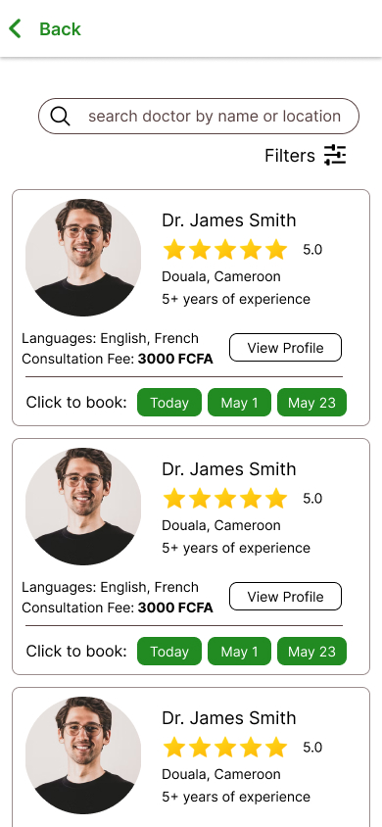

Slide 15
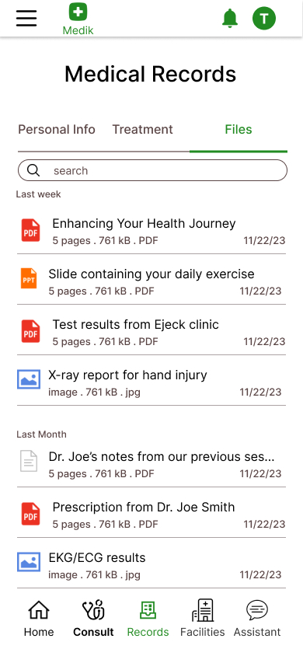
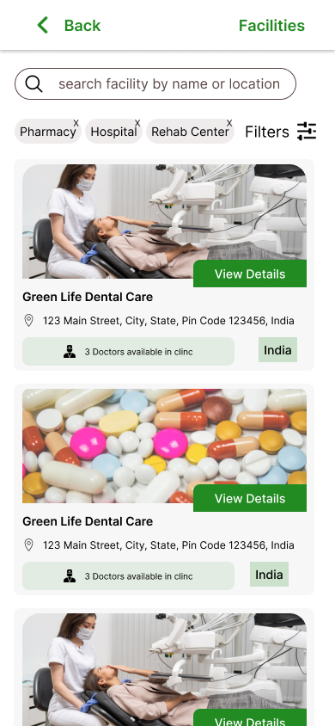
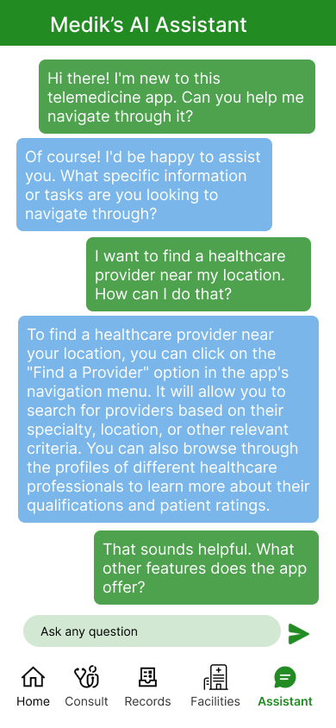

Slide 16
3) DATABASE DESIGN

Slide 17
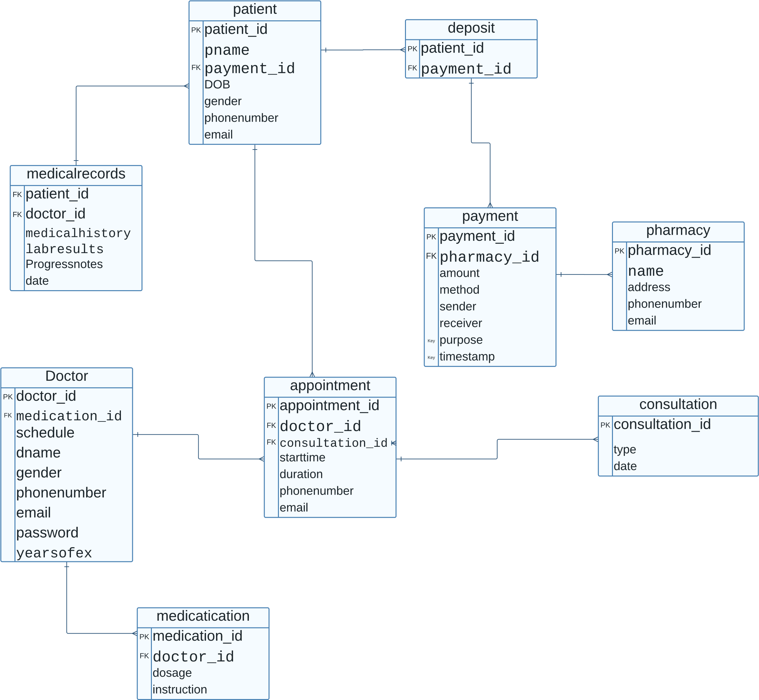

Slide 18
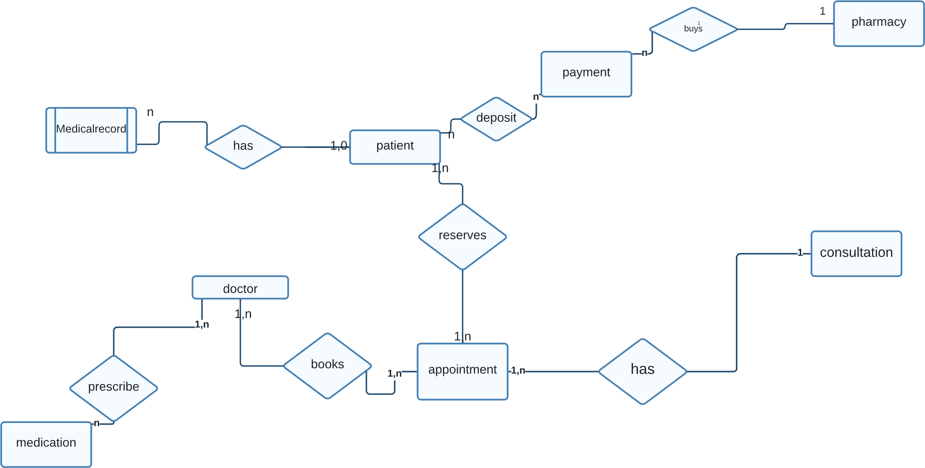

Slide 19
SOME REFERENCES
Morgan, L. A. (2022). HIPAA: A Practical Guide for Covered Entities and Business Associates.
2. Woodcock, J. (2018). ISO 13485:2016 Quality Management Systems - Medical Devices - Application of ISO 9001:2015 for Regulatory Purposes.
3.International Electrotechnical Commission. (2005). IEC 60601-1:2005 Medical electrical equipment - General requirements for safety
4.ITSourceCode. (n.d.). Telemedicine Online Platform Database Design. Retrieved from https://itsourcecode.com/free-projects/database-design-projects/telemedicine-online-platform-database-design/#google_vignette
5. Wikipedia. (n.d.). ISO/IEC 15288. Retrieved from https://en.wikipedia.org/wiki/ISO/IEC_15288

